Slide 1
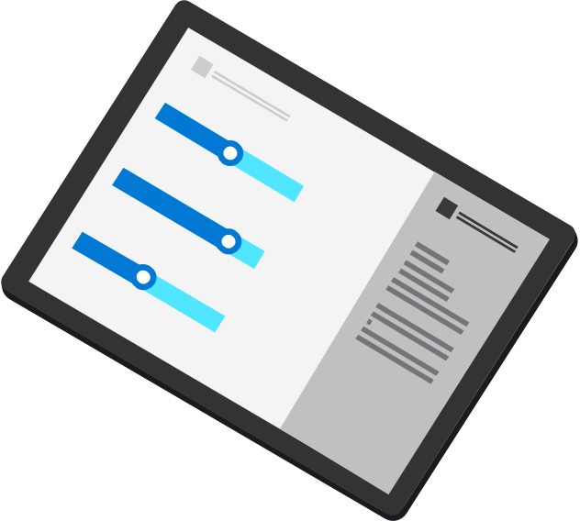

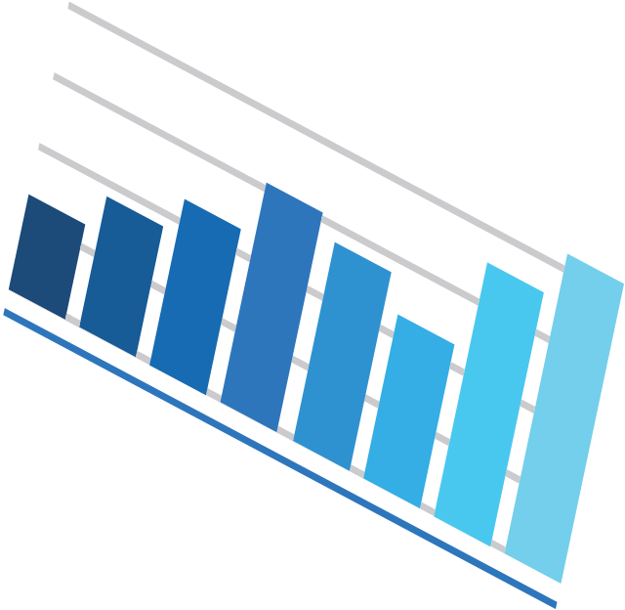



Analytics
ANALYTICS

Slide 2
Today’s data realities
3
What data do I have?
Data governance
Is it trustworthy?
2
Can people access the data needed to make the right decisions?
Analytics
1
How can I enable faster business insights?
Operational Databases
Operational databases
What’s my compliance exposure?
Notes:
…And doing this isn’t easy, given the realities of data today. The volume, variety and velocity of data are all accelerating dramatically, and the complexity of creating of an enterprise ‘knowledge graph’ can seem insurmountable. Today we generate data far faster than we are able to understand it
In fact, IDC predicts that by 2025, just 5 years from now, the world’s data will climb to 175 zettabytes. To put that in perspective, if you were to store that data in a stack of BluRay discs you’d be able to go to the moon and back 23 times!
Without the right people, processes and capabilities in place, it can be difficult to answer fundamental questions like:
What data do I have?
Is it trustworthy?
Are people getting the data they need to make the right decisions?
Are they getting it fast enough?
And are we managing data in a compliant way?...

Slide 3
Introducing Microsoft Intelligent Data Platform
2
Transform with the Microsoft Cloud
Microsoft Cloud
Dynamics 365 • Microsoft 365 Power Platform
3
Data governance
2
Analytics
1
Operational databases
2
Microsoft Intelligent Data Platform
SQL Server • Azure SQL • Azure Cosmos DB • Azure Synapse Analytics
Azure Databricks • Power BI • Microsoft Purview • Azure AI
Notes:
Getting the right answers to these questions is possible when all your data assets are connected and managed in a cohesive fashion. This is why we announced the Microsoft Intelligent Data Platform, the leading cloud data platform that empowers organizations to invest more time creating value rather than integrating and managing their data estate.
The platform is made up of capabilities across databases, analytics and governance that, on their own, meet specific business needs and already bring many benefits but together helps easily evolve applications to include advanced analytics and intelligence. It is the integration of the products you are already using today to accelerate innovation and achieve agility, across our cloud, as well as others
We want to remove key points of friction between your databases and analytics systems while ensuring your full data estate can be automatically mapped and governed
Organizations can analyze large volumes of operational data in near real-time with no extraction, transformation, or loading (ETL) pipelines, and no performance impact on transactional workloads
And anyone in the organization, whether they’re a data scientist, data analyst or a domain expert, can access, analyze, and share data
This is the state we are all aiming for is where we can:
Accelerate innovation, Focus on what matters most – your business. Free resources to create frictionless customer experiences, transform products and empower employees.
Achieve agility, Pivot faster to respond to dynamic environments with an integrated data platform that adapts to your needs with hybrid and multi cloud capabilities. Build how you want, deploy where you want and gain fast, continuous insights.
Build on a trusted platform, Deliver data-powered experiences with the security and privacy controls required to innovate with confidence. Azure provides the most comprehensive protection for your valuable business data.

Slide 4

Transform with the Microsoft Cloud
Transform with the Microsoft Cloud
Introducing Microsoft Intelligent Data Platform
2
Microsoft Cloud
Dynamics 365 • Microsoft 365 Power Platform
1
2
1
2
3
Microsoft Intelligent Data Platform
SQL Server • Azure SQL • Azure Cosmos DB • Azure Synapse Analytics
Azure Databricks • Power BI • Microsoft Purview • Azure AI
Operational databases
Analytics
Data governance
Operational databases
Analytics
Data governance
Operational databases | Analytics | Data governance
Notes:
We're also integrating The Intelligent Data Platform with the rest of the Microsoft Cloud, for enabling richer data experiences for business users of Microsoft 365 and Dynamics 365 and Power Platform.

Slide 5
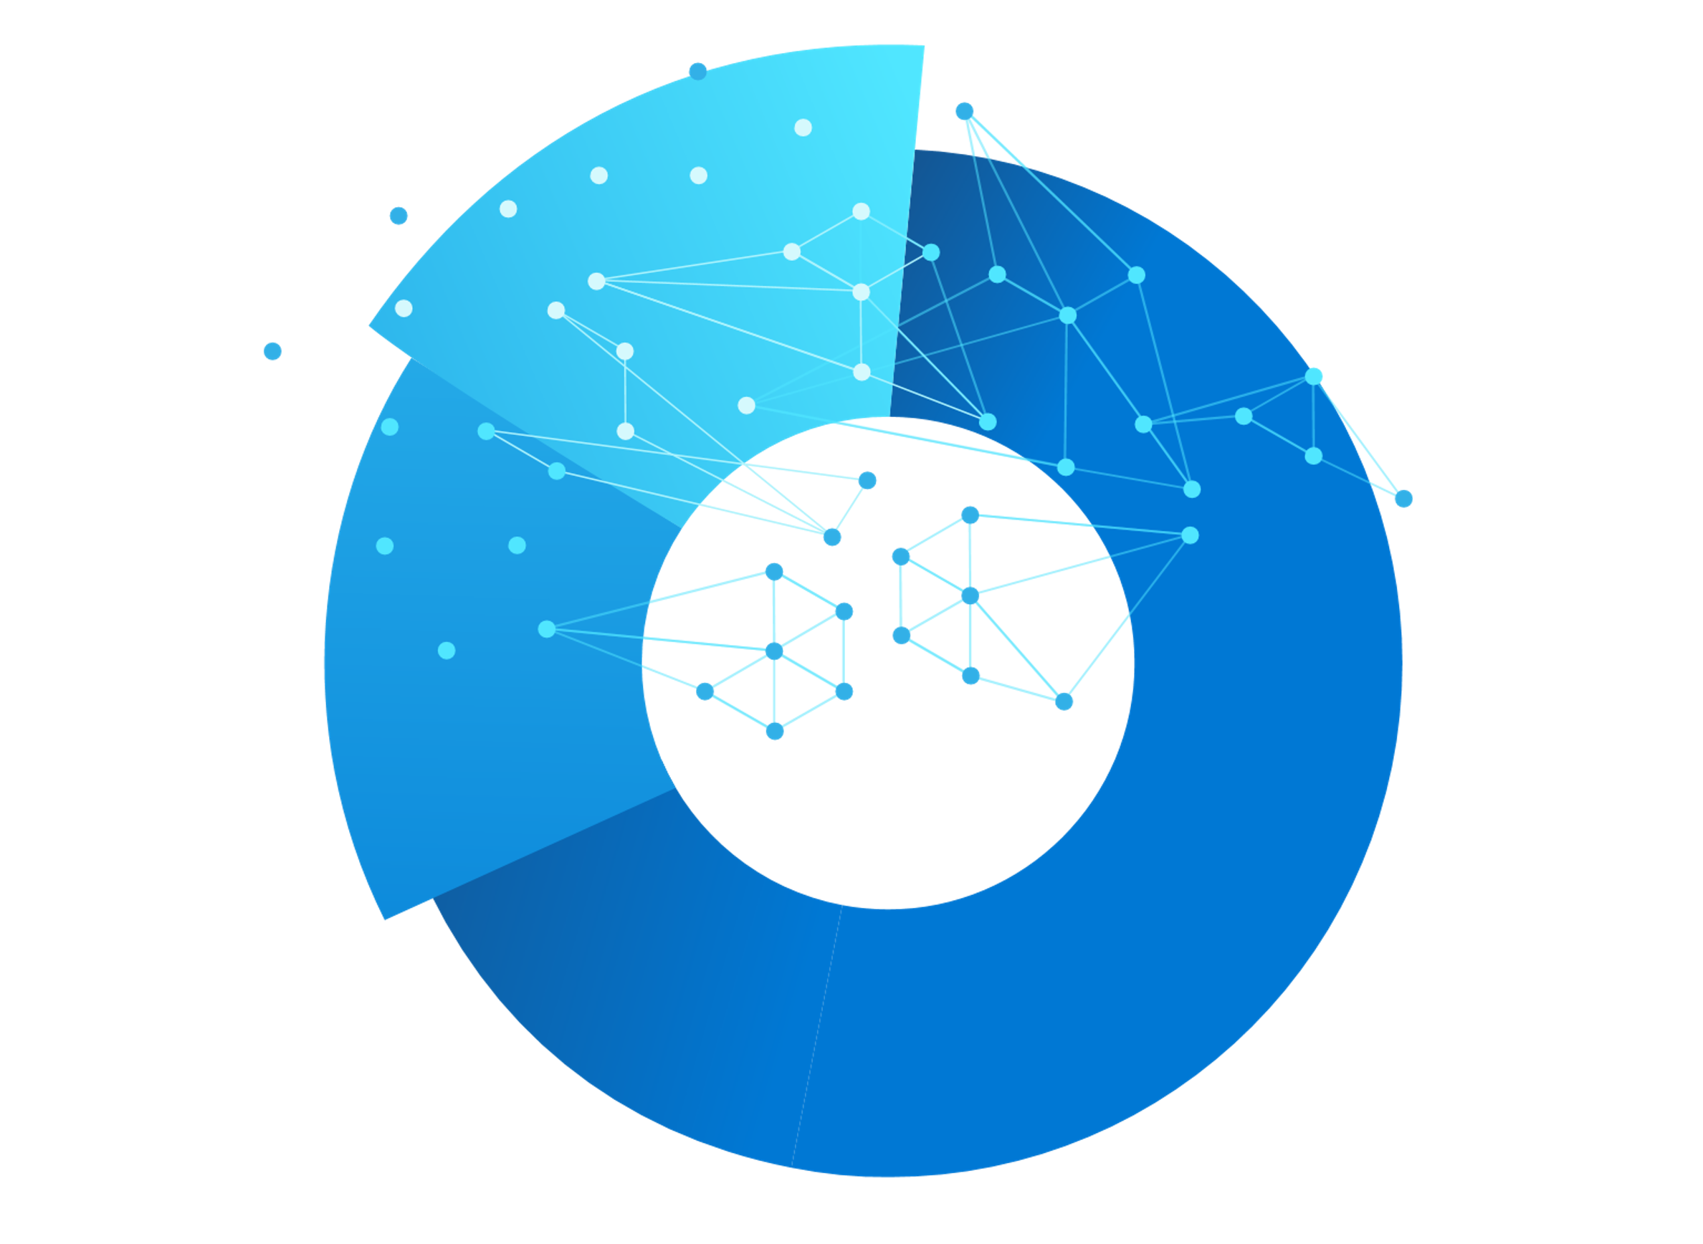
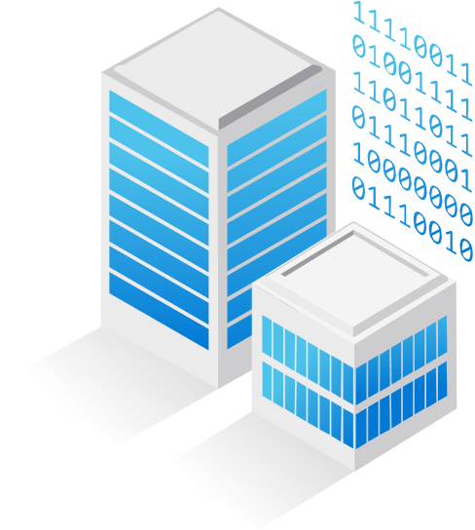

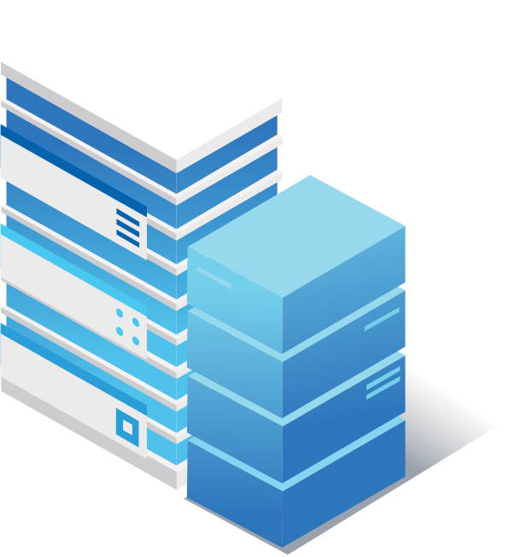

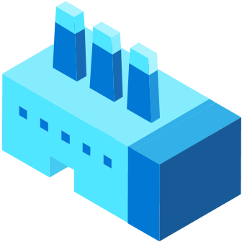
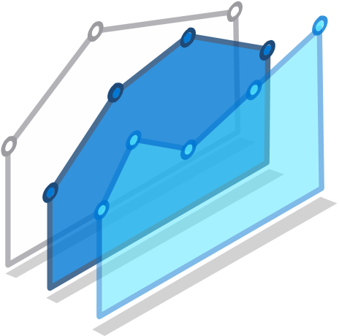
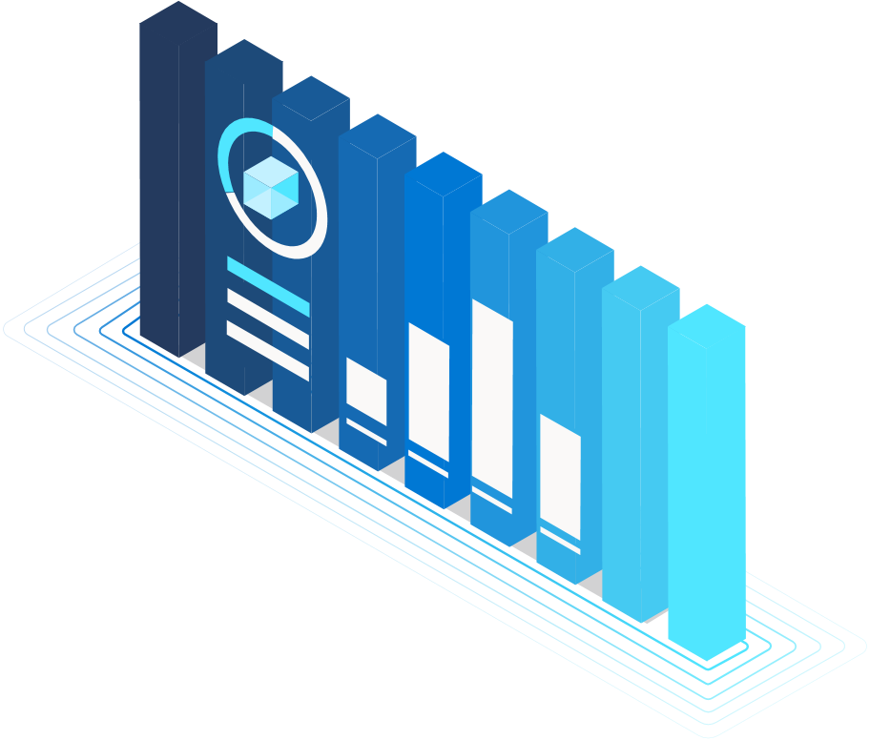


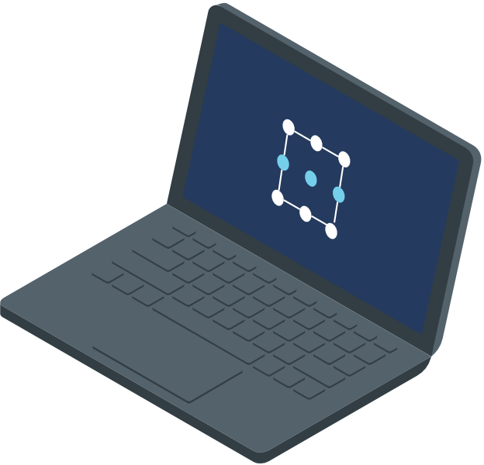

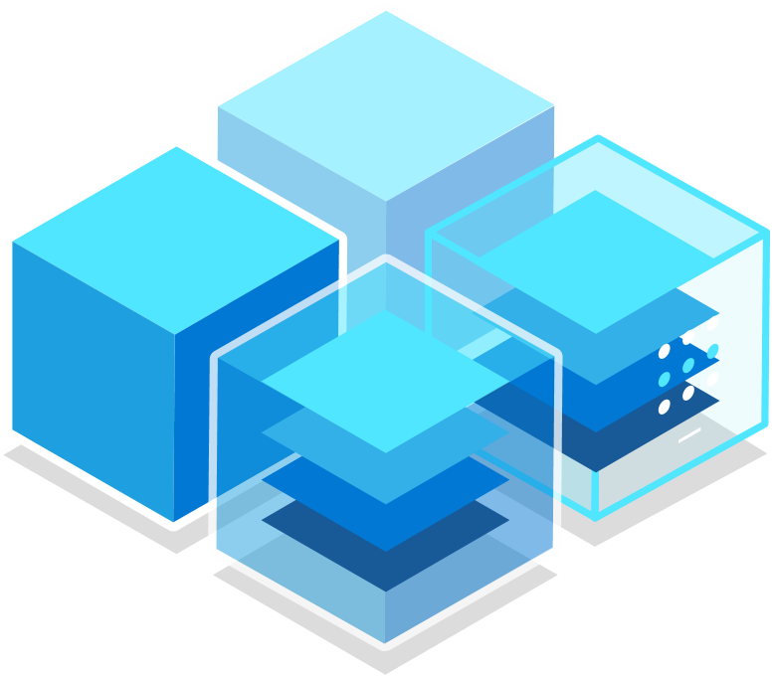



Analytics & AI play a pivotal role for organizations at all times
Address disruptions in business processes
Save on costs & reduce CAPEX
Discover fresh new insights
NEED FOR FASTER TIME-TO-INSIGHT

Slide 6
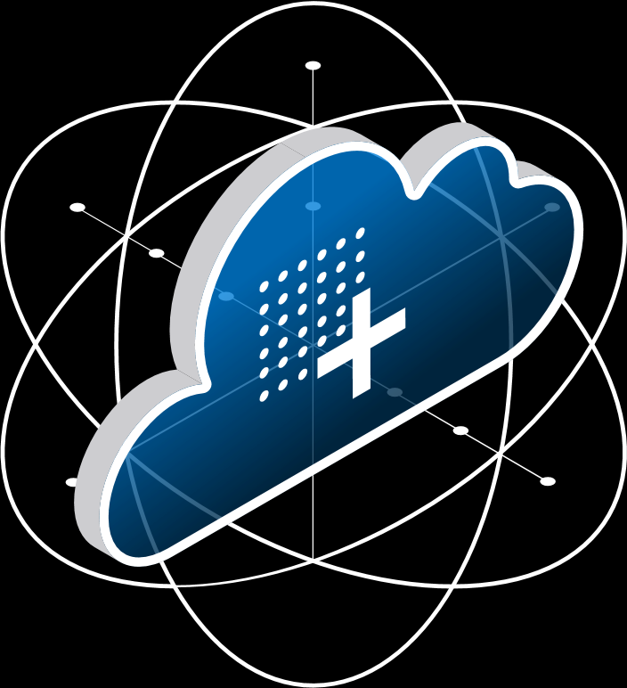
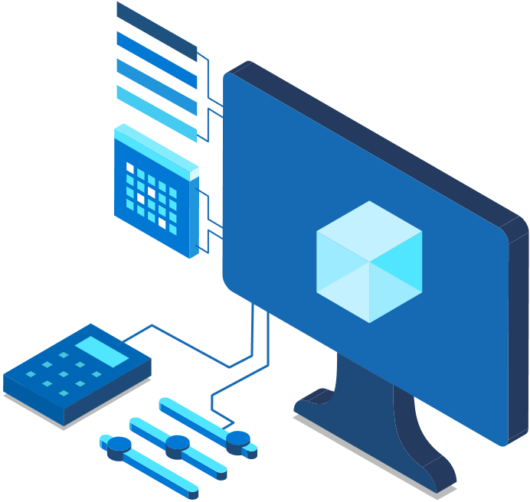
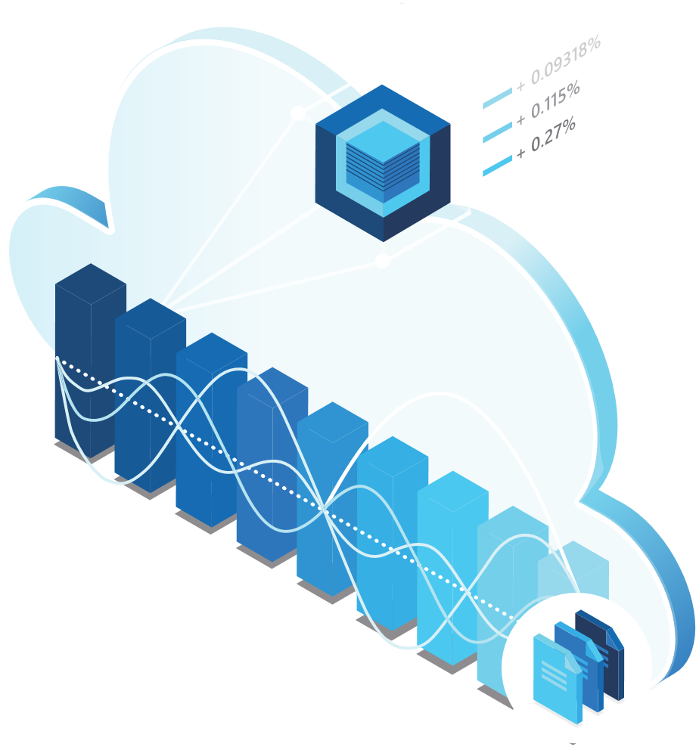
Now, more than ever, cloud analytics is the critical first step to resilient business transformation
Implement insights-driven decisions in minutes—not days
Adapt to a changing status quo with the intelligent use of analytics and the ability to go from hypothesis to validation in minutes using ALL your data.
Only pay according to your critical business needs
Quickly ramp-up data and analytics tools whenever your business needs demand it and pause it when no longer needed. Deliver cost efficient chargeback/show back to your business partners.
Reduce high CAPEX projects & increase cost savings
Costs that would have gone to buying hardware and managing infrastructure are put directly back into the business

Slide 7

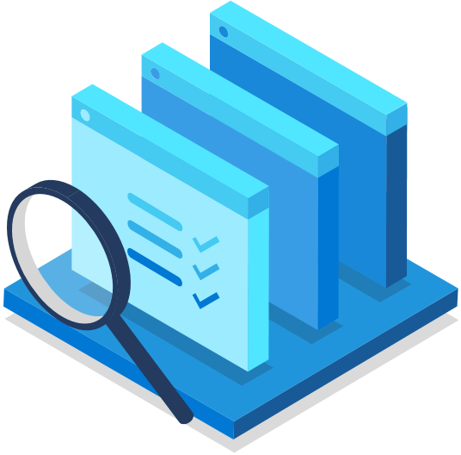
Cloud analytics paves the path of lasting business transformation, with continual ROI throughout the journey
Faster time-to-insight
Spend less time tuning appliances or stitching services together & more time understanding the new realities of your operations and customers using all your data.
Discover savings opportunities
Less time managing infrastructure and siloed projects means more time to optimize current processes & create positive change.
Be prepared for tomorrow
Cloud analytics solutions enable customers to be agile by integrating big data, data warehousing, machine learning, and business intelligence projects into one well-architected service.

Slide 8
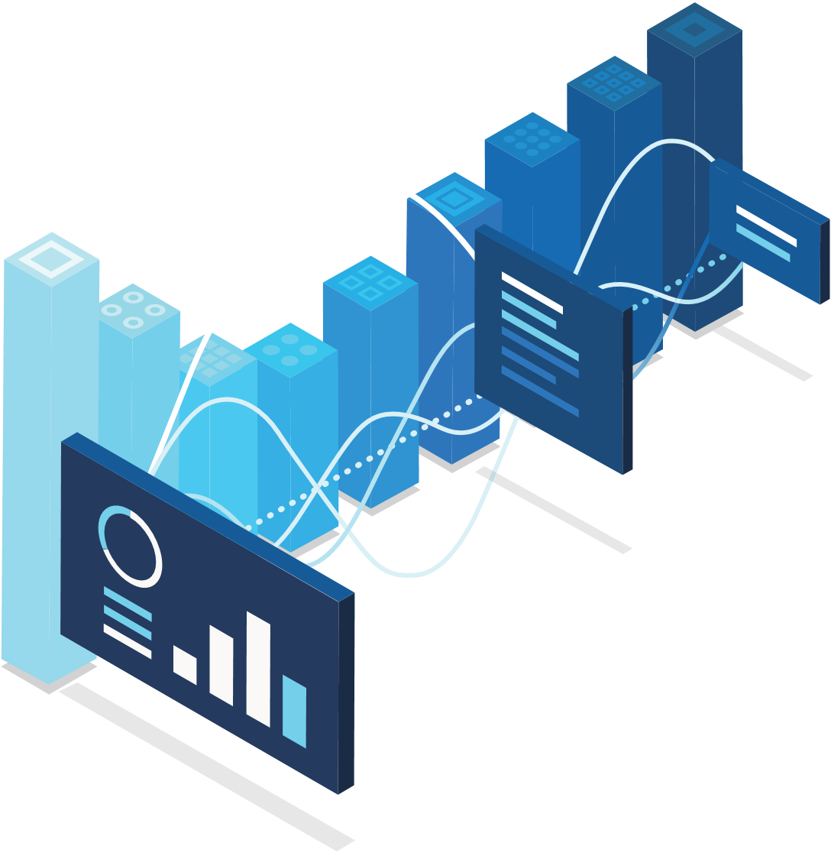

Customers using Analytics in Microsoft Azure are transforming their business with purpose
271%
Average ROI
60%
Increased customer satisfaction
27%
Faster time to insights
26%
Lower total cost of ownership
* Forrester, October 2019, “The Total Economic Impact of Microsoft Azure Analytics with Power BI”
Notes:
Forrester report: https://azure.microsoft.com/en-us/resources/forrester-tei-microsoft-azure-analytics-with-power-bi/

Slide 9

Analytics & AI is the #1 investment for business leaders, however they struggle to maximize ROI
80% report struggling to become mature users of data*
55%
report data silos and data management difficulties as roadblocks*
* Harvard Business Review (2019), Understanding why analytics strategies fall short for some, but not for others

Slide 10
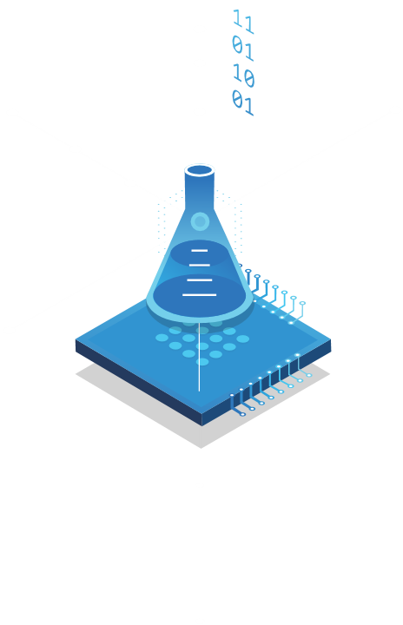
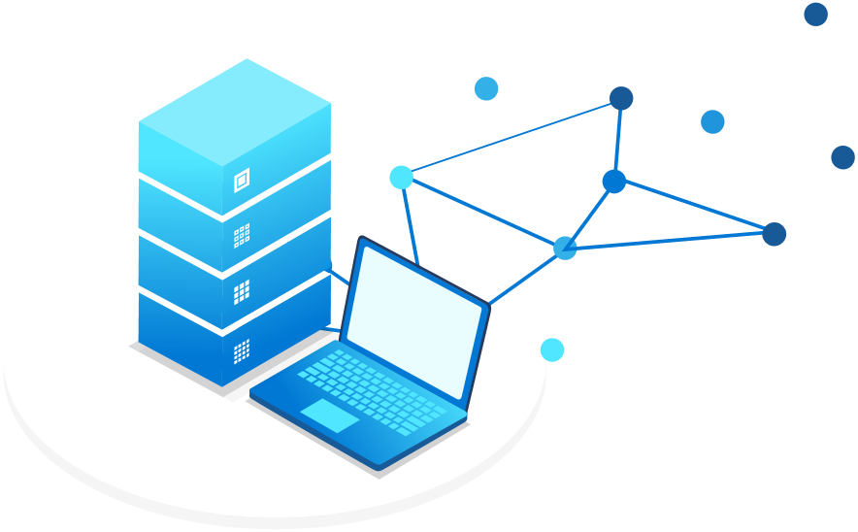
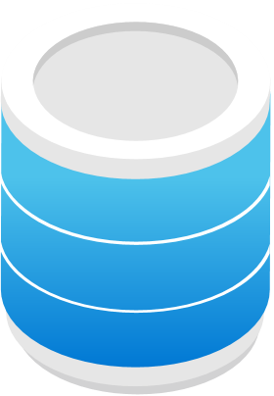
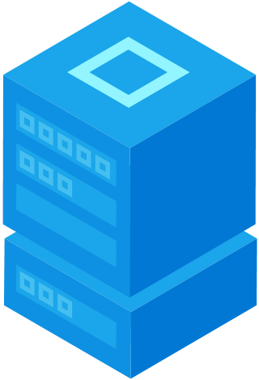
Data Science and Business Analytics
view data in very different ways
DATA SCIENCE
BUSINESS ANALYTICS
Big data
Experimentation
Fast exploration
Semi-structured
Relational data
Proven security & privacy
Dependable performance
Structured
OR
DATA LAKE
DATA WAREHOUSE

Slide 11
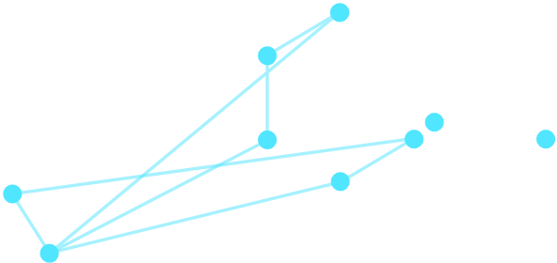
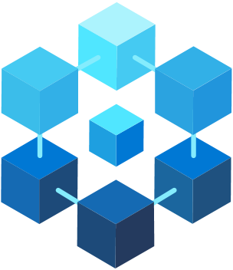


Azure meets these challenges
with a single service to provide limitless analytics
Ease of use
Fast exploration
Quick to start
Proven security
Airtight privacy
Dependable performance

Slide 12

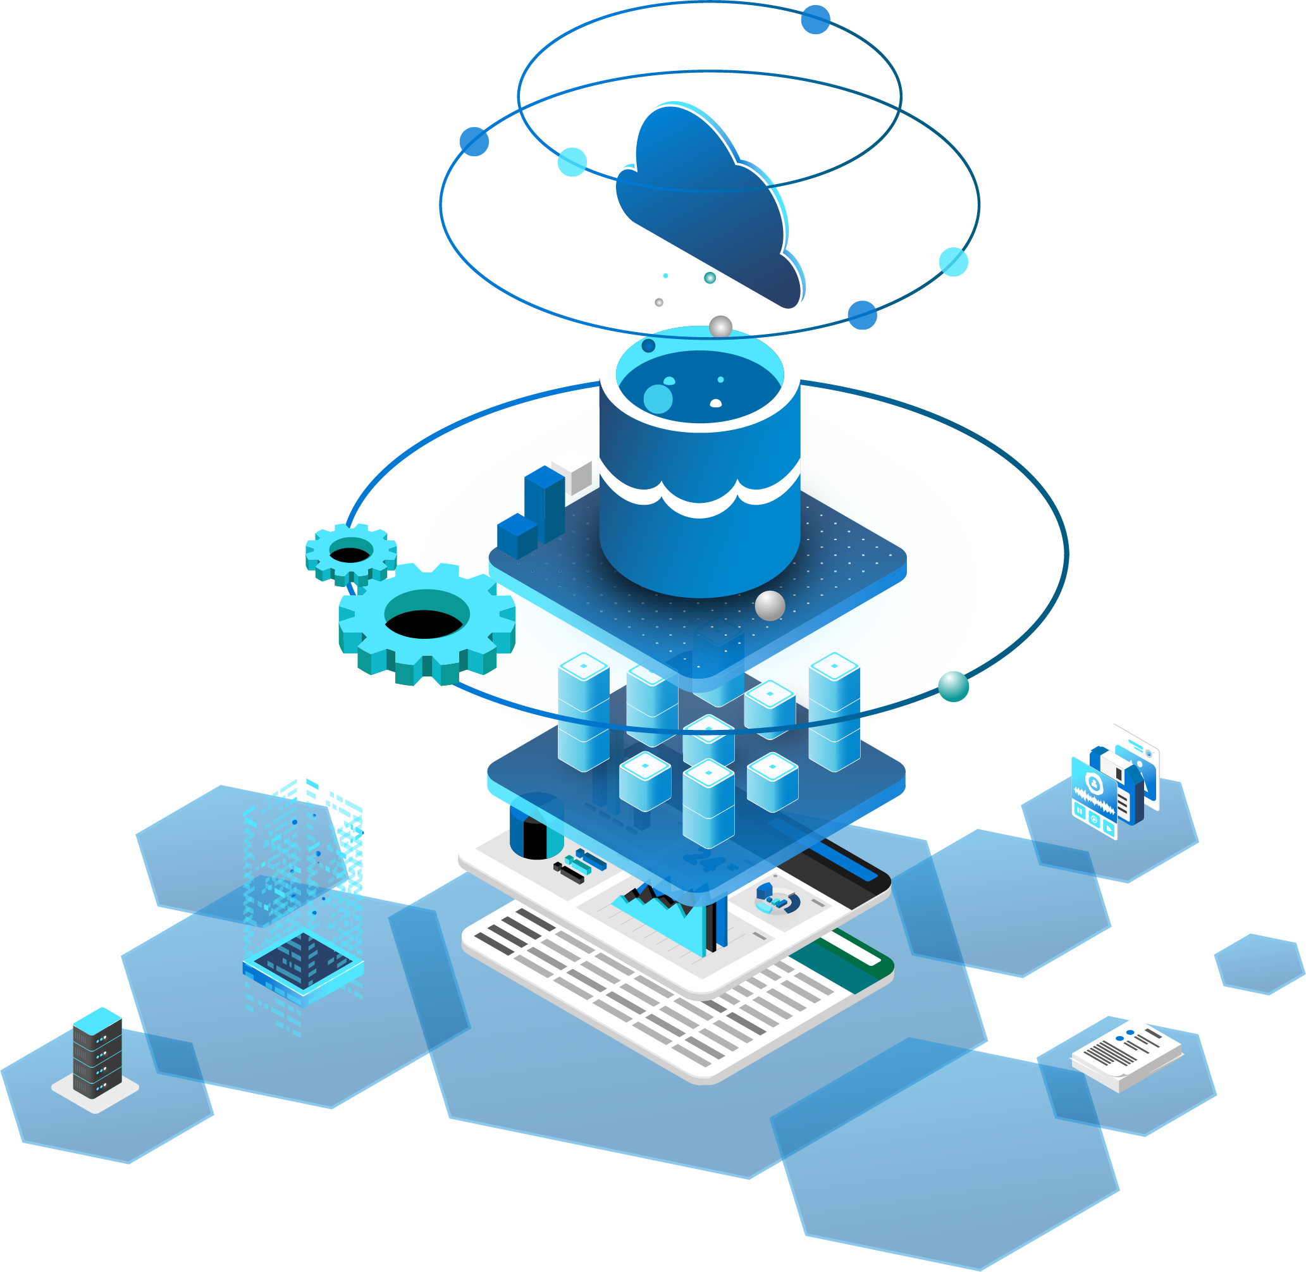
Azure Synapse Analytics
Data Warehousing & Big Data Analytics
ALL IN ONE SERVICE
WELCOME TO LIMITLESS

Slide 13
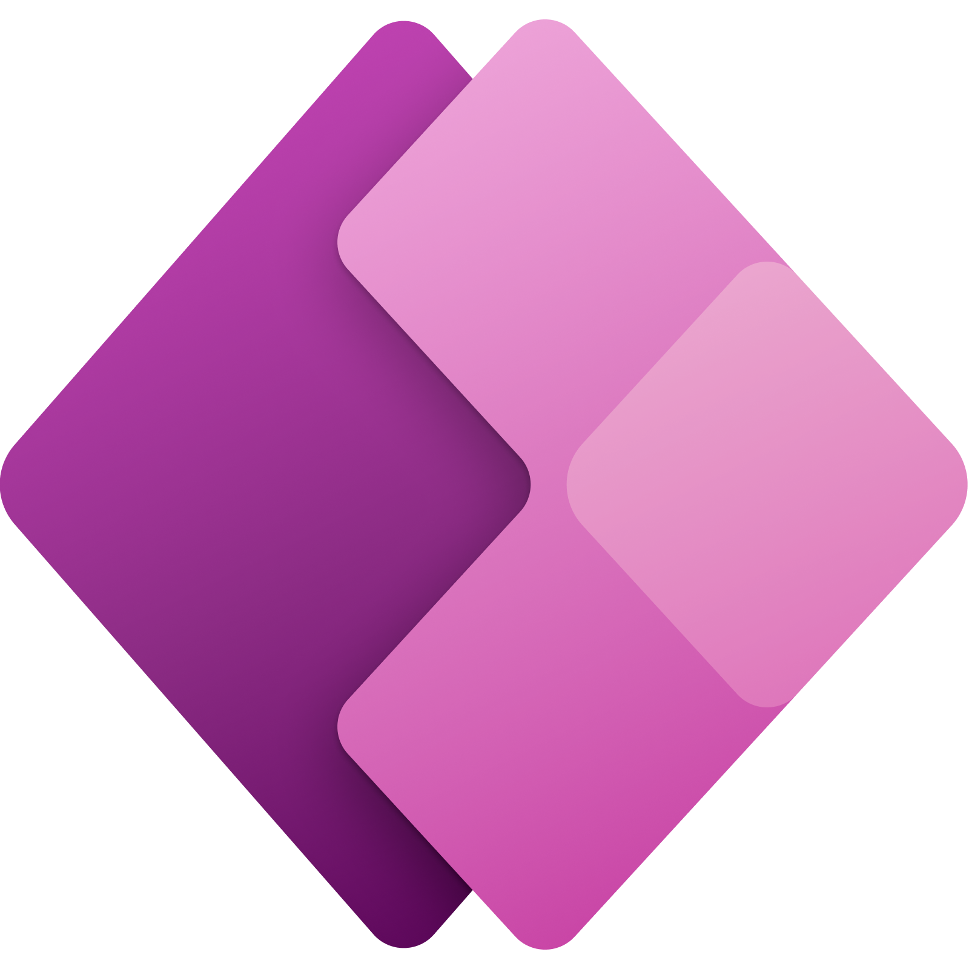



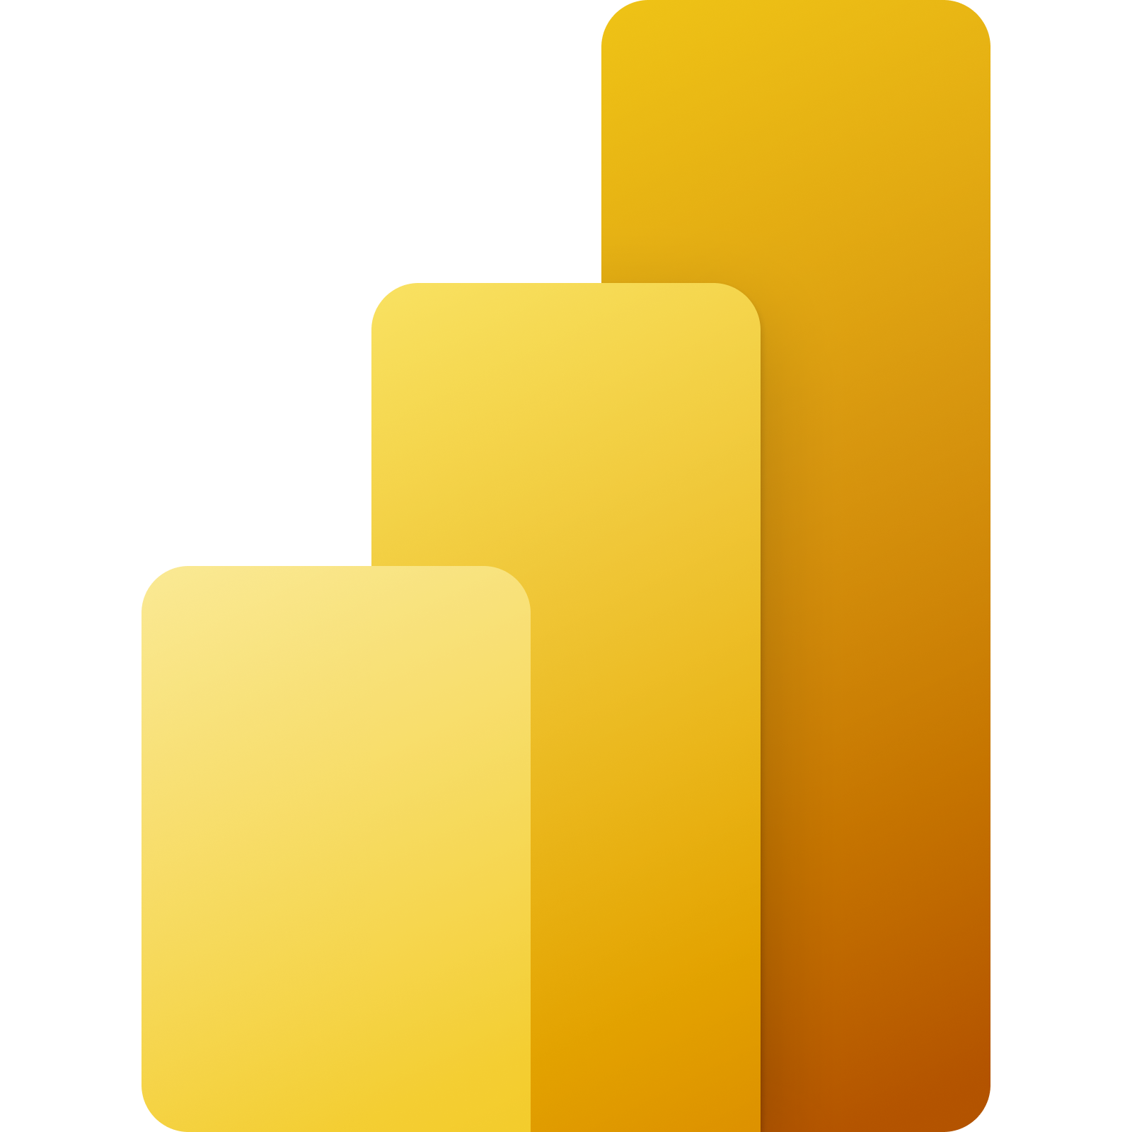
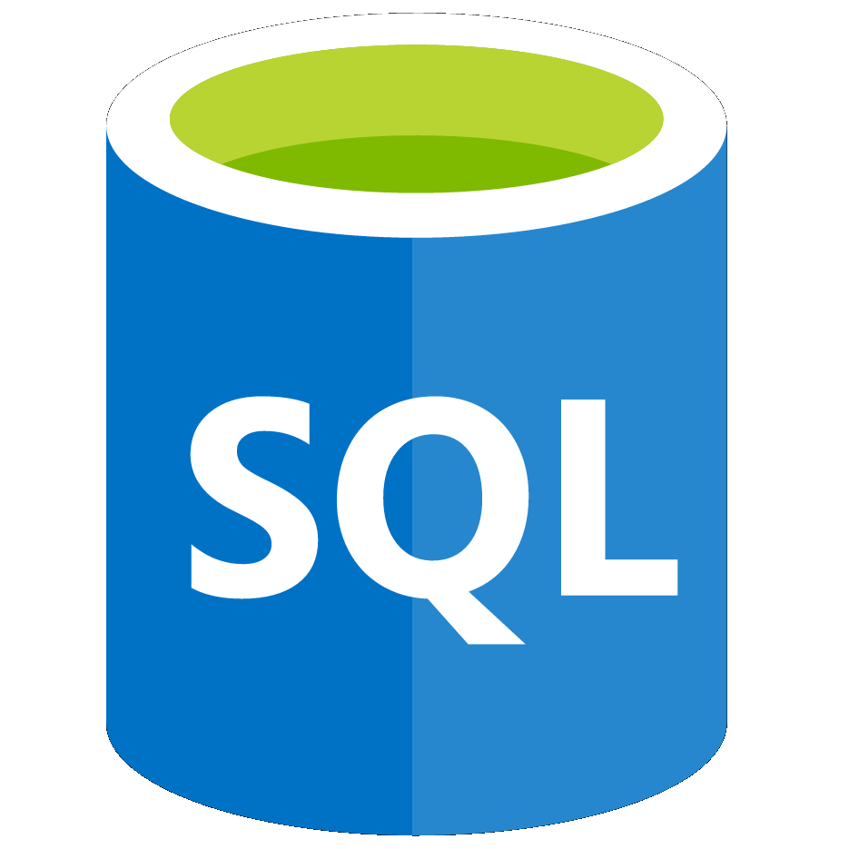



Azure Synapse Analytics does it all
The first unified, cloud native platform for converged analytics
Unified Experience
Azure Synapse Studio
On-prem
Integration
Database Templates
Management
Monitoring
Security
DevOps
Cloud data
Analytic runtimes
SQL
Data Explorer
Applications
Semantic Layer – Common Data Model
Streaming data
Data Warehouse
Data Lake
Event Brokers
Azure Synapse Link
Cosmos DB
Dataverse
Notes:
Azure Synapse unifies your data, your data tasks, and your data teams with a limitless analytics service that does it all. This is the result of a multi-year effort.
We set out to rearchitect and create the next generation of query processing and data management with Synapse to meet the needs of the modern, high scale, volume, velocity, and variety of data workloads.
As these modern workloads require both SQL and Apache Spark, we saw that customers would need a cloud-native analytics service engine that converged big data and data warehousing so they could achieve limitless scale on structured, semi-structured, and un-structured data.
Kim

Slide 14
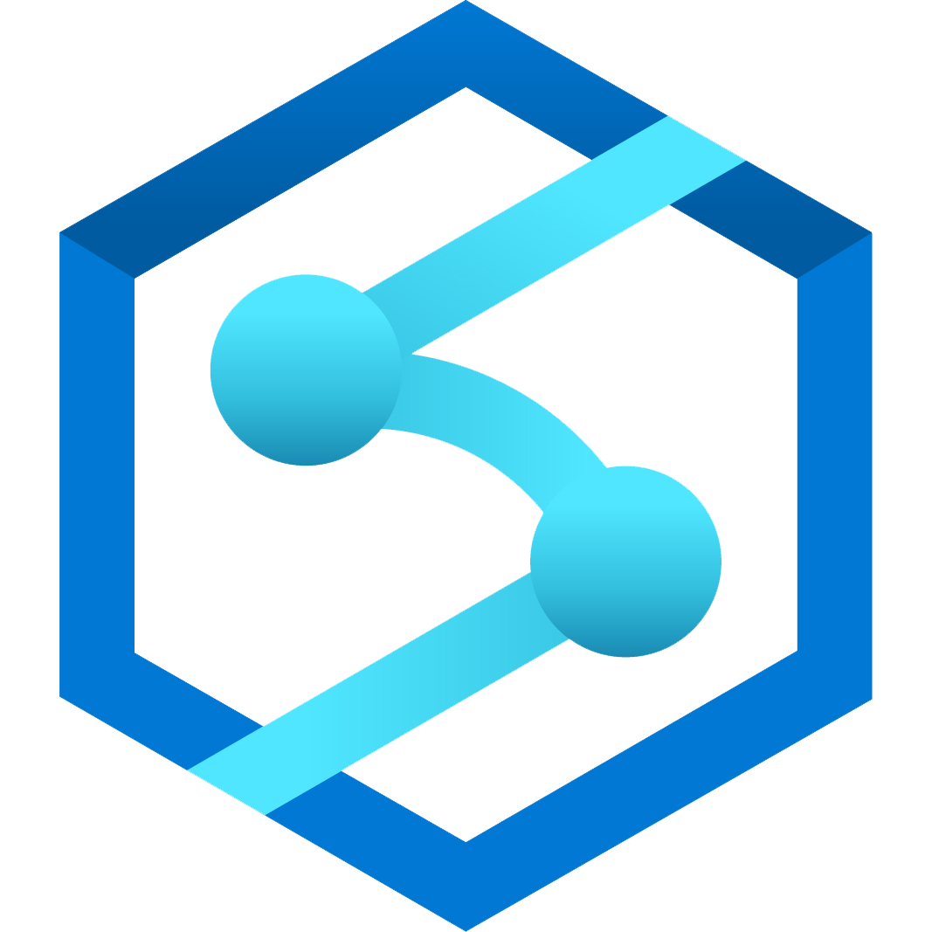
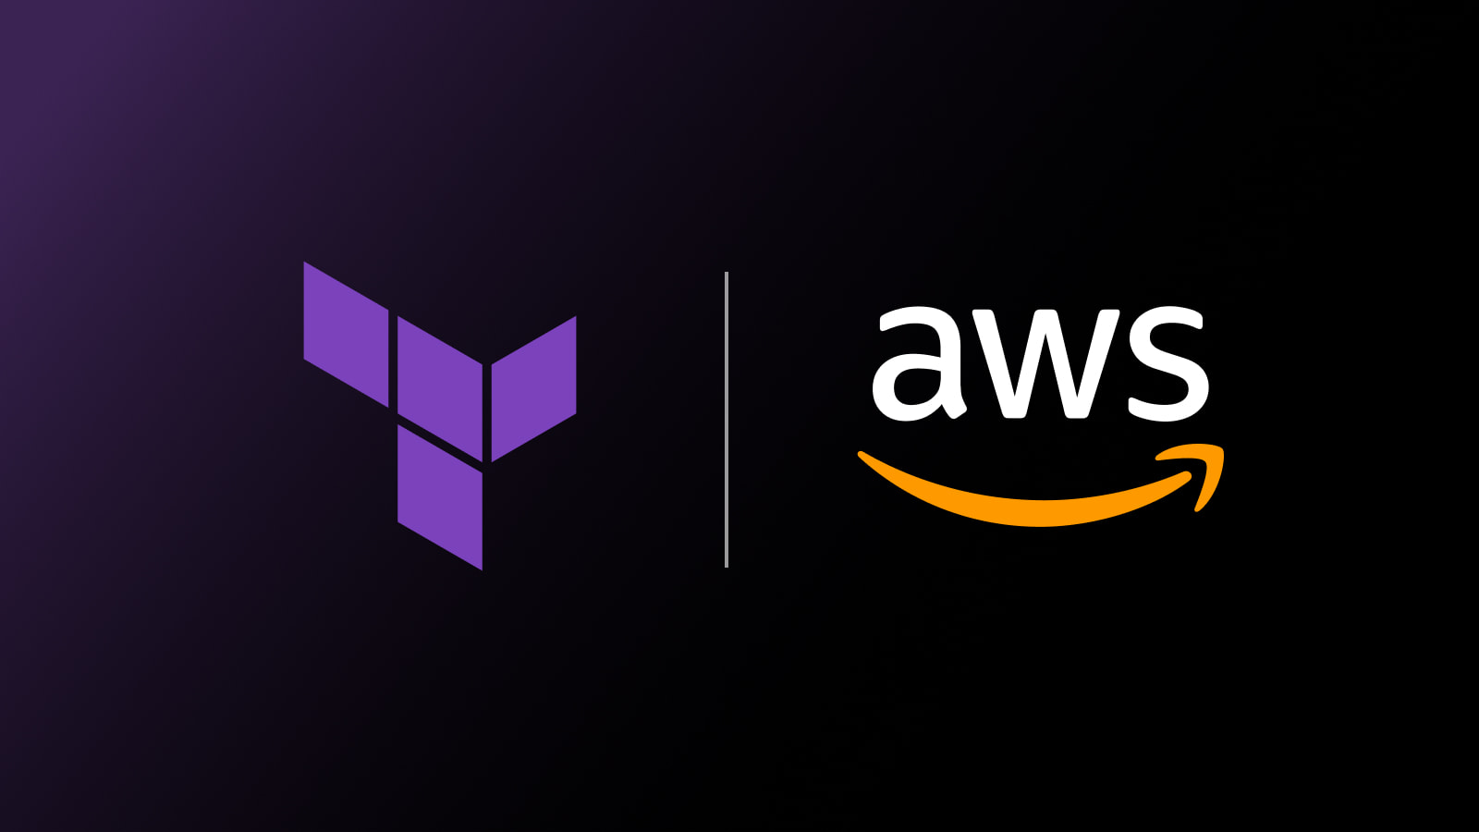


A breakthrough in the cost of enterprise analytics
3-Year Total Cost of Ownership
With the best price-performance in the business
Up to 14x faster and costs up to 59% less than other cloud providers
$43M
$24M
$24M
$19M
$15M
$12M
$6M
$7M
MEDIUM ENTERPRISE
LARGE ENTERPRISE
* GigaOm TPC-H benchmark report, June 2021, “GigaOm report: Data Warehouse in the Cloud Benchmark"

Slide 15
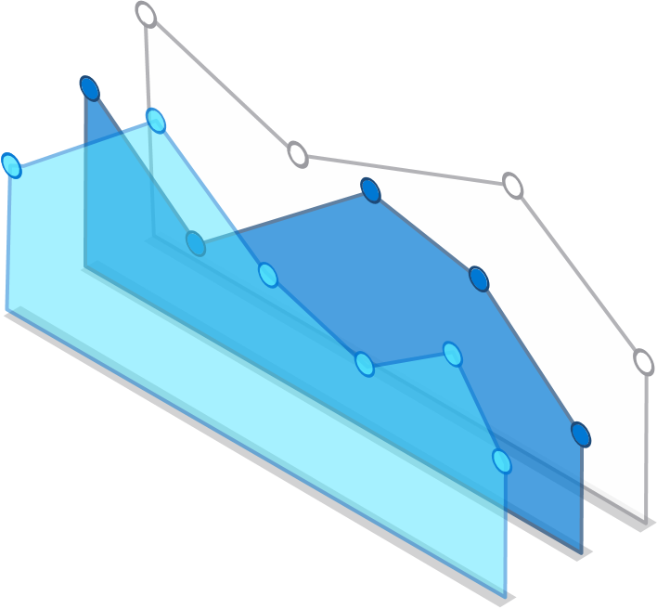









Azure Synapse
LIMITLESS SCALE
POWERFUL INSIGHTS
UNIFIED EXPERIENCE
CONVERGED ANALYTICS
UNMATCHED SECURITY
Notes:
What’s different with Azure Synapse is simple enough – with the complexities of architecture taken care of in a single, unified platform, your people are free to focus on real business value. Analytic value.
What emerges from this is analytic power and insight in every team and every practice of the business. You no longer integrate together architectural components to meet a pre-specified purpose, hoping for both flexibility and economy in the end. Instead, those needs are met from the beginning and what emerges is a continuum of analytic capabilities.
With Azure Synapse there is a single point of management for significant services shared with the Azure platform.
Performance and scale for all analytic capabilities are managed together.
Skills and training are greatly simplified
Finally we can stop talking about architecture … and focus on analytics.

Slide 16
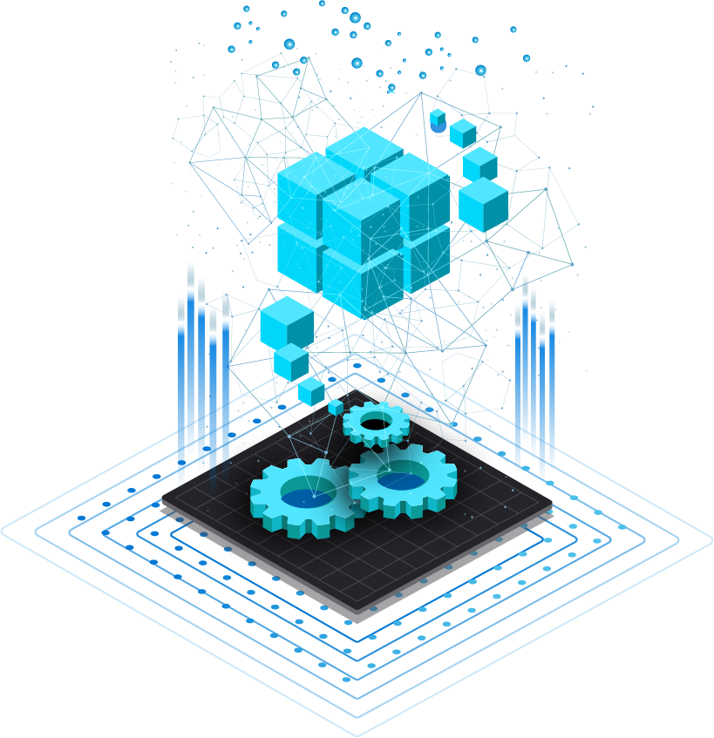



Limitless scale provides a breathtaking view of your data
All of it, from warehouses to data lakes with limitless scalability, provisioned or serverless, and intelligently optimized workload performance.

Slide 17
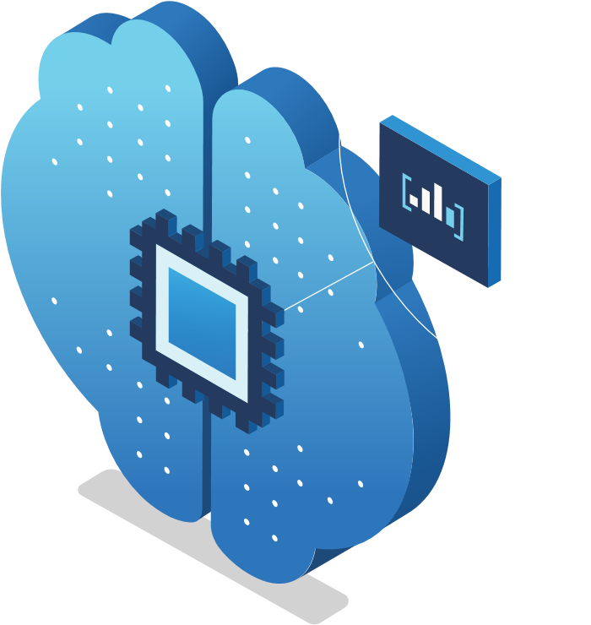
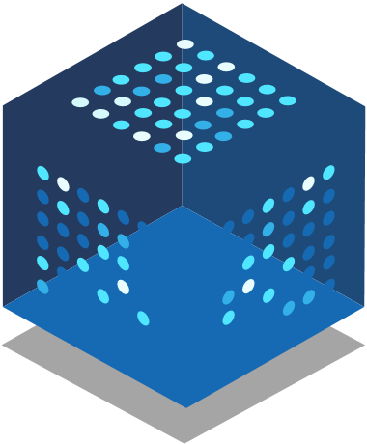
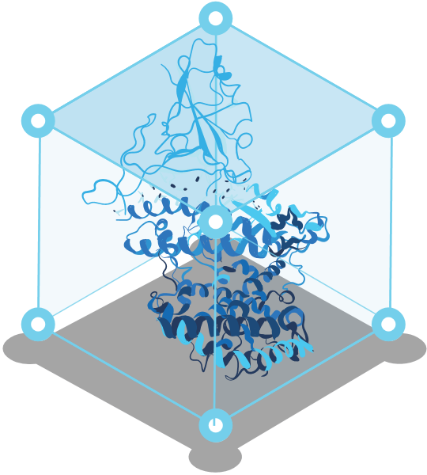

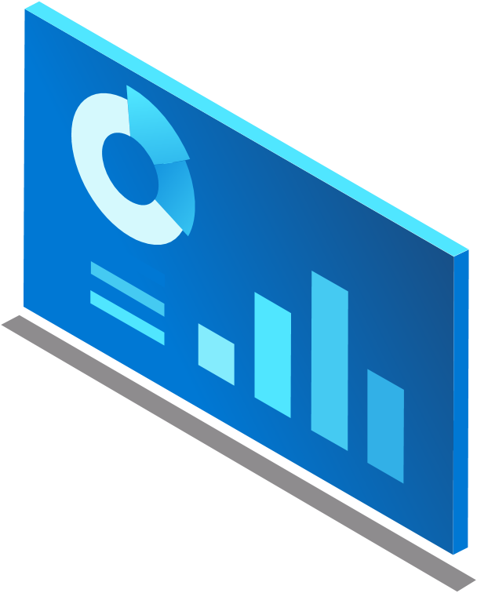
Unlock powerful insights with a multi-layered grasp of your business
Integrated BI and machine learning drives insight for all users from the data scientist, coding with statistics, to the business user with Power BI.

Slide 18
Build end-to-end analytics solutions with a unified experience
A consistent version of data for everyone and all analytics use cases, but with zero management and maintenance, and an SLA backed with hard finance.

Slide 19
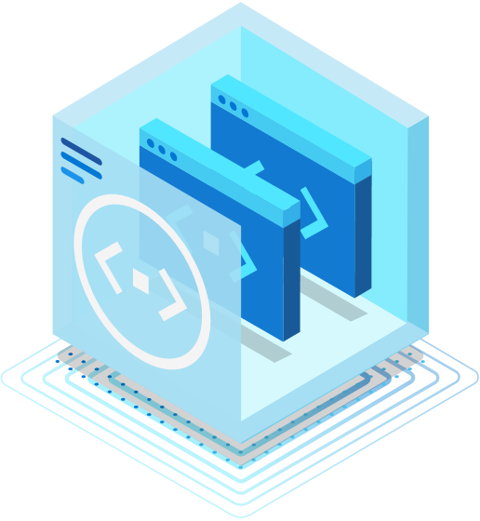
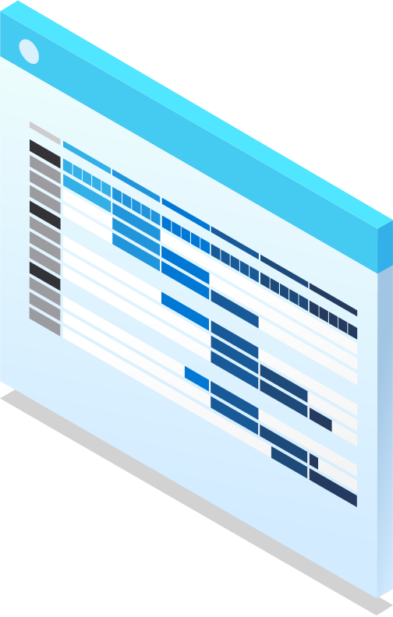
Use the freshest data possible with converged analytics for all your data workloads
Bring immediate, in-the-moment insights to your business by linking operational and analytical data together, with a single click.

Slide 20
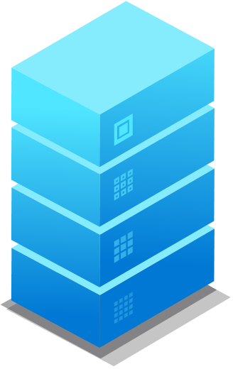

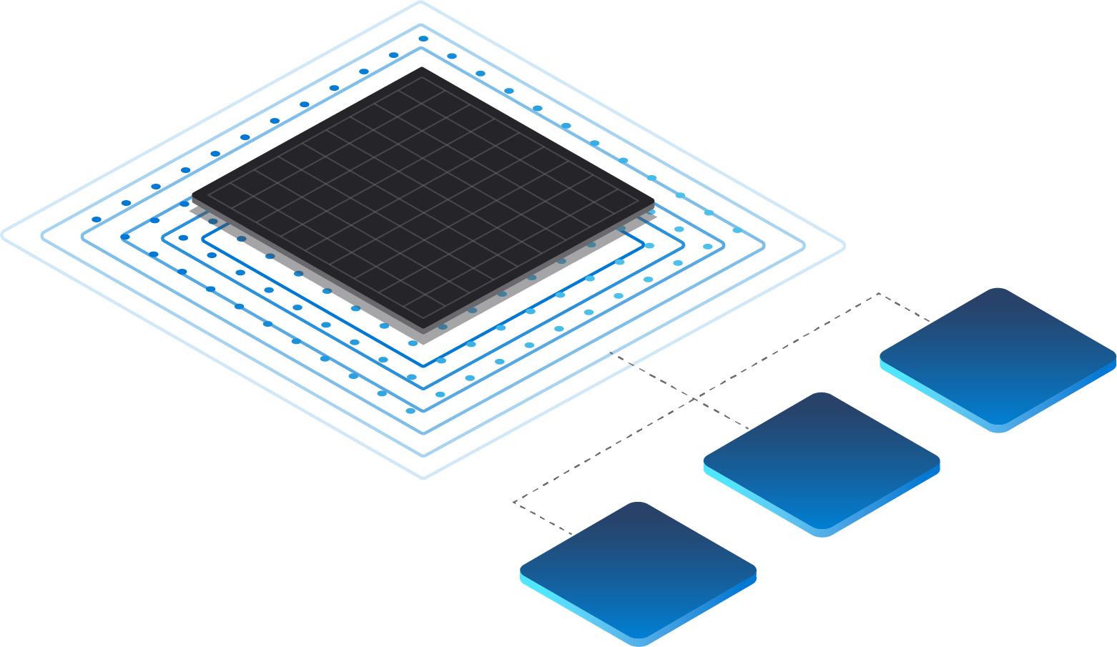



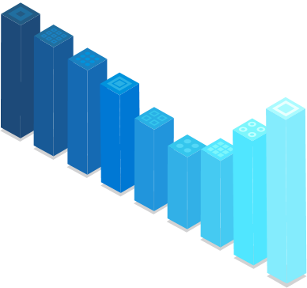
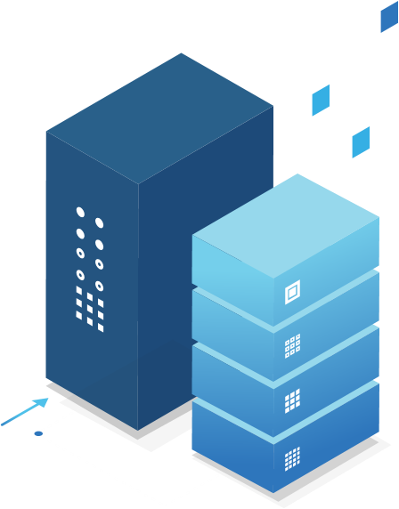

Data is constantly growing across your business
Relational Databases
Business Apps
Operational Databases

Slide 21
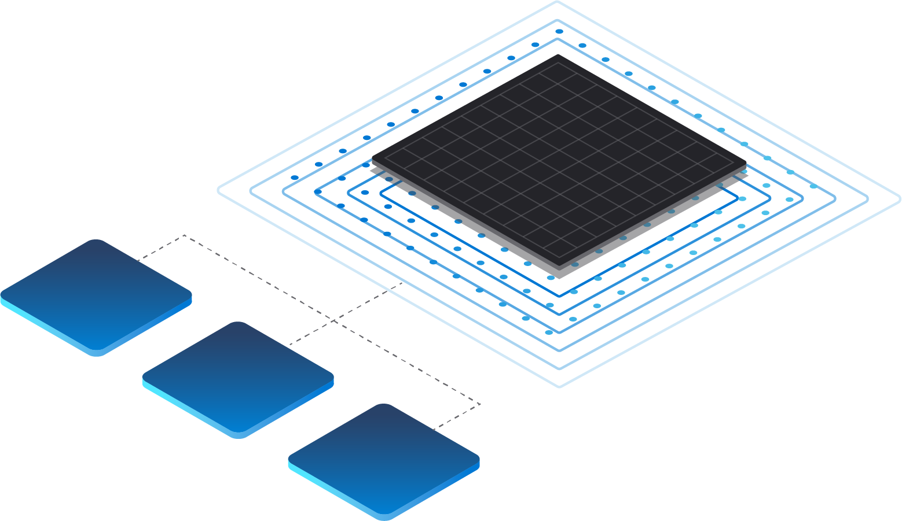
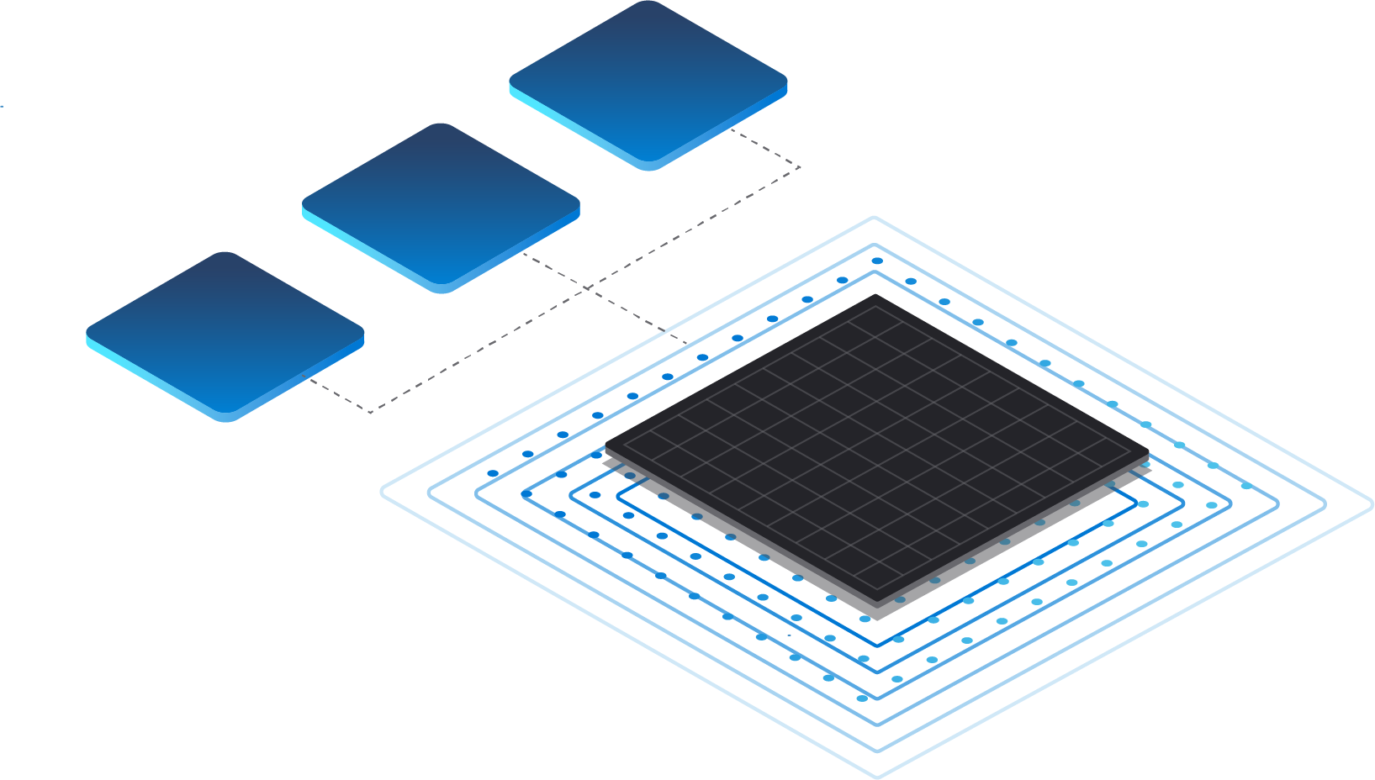
Preparing data to be analytics-ready requires various processes
Operational Databases
Relational Databases
EXTRACT
TRANSFORM
LOAD
Business Apps

Slide 22

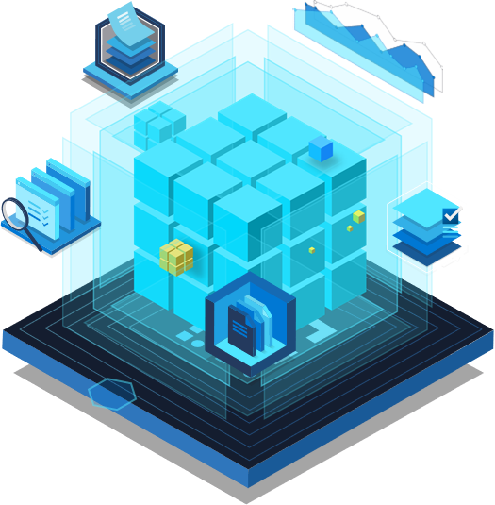
These processes result in additional issues that stall data insights
Operational Databases
Relational Databases
EXTRACT
TRANSFORM
Data Pipelines
LOAD
Analytics Destination
Business Apps

Slide 23
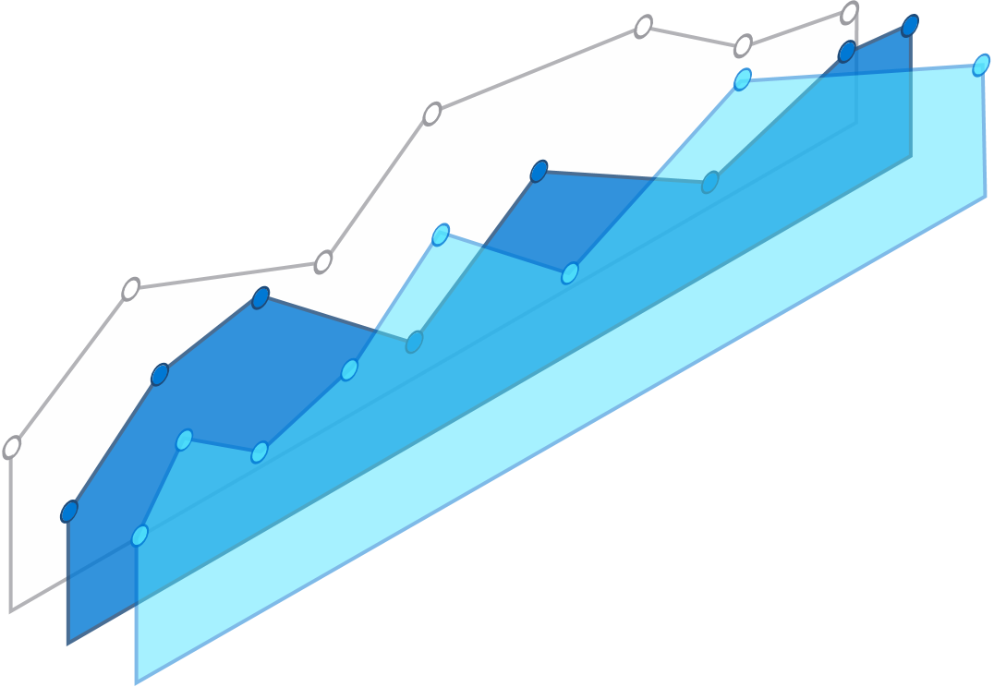
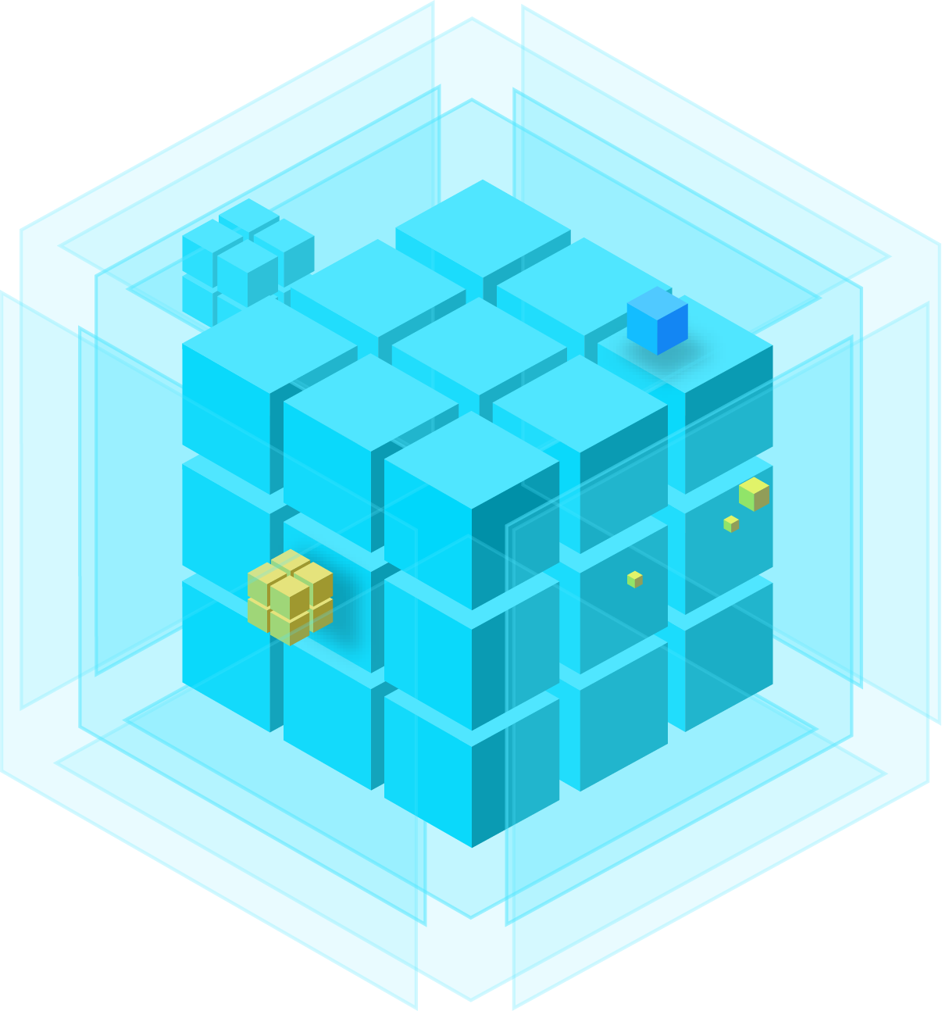




Azure Synapse Link
Azure Synapse Link
for Cosmos DB
Azure Synapse Link
for SQL
Operational Databases
Operational Databases
No managed ETL
Built for convergence
Power BI
Near real-time analytics
Azure Synapse Link
for Dataverse
Azure Synapse Analytics
Business Apps
Notes:
No data integration pipelines required
Latency <90s at 99th percentile
Near real-time insights on transactional data with no performance impact
1-click experience for Power BI dashboard

Slide 24
A rigorous assurance of safe-keeping with the most advanced security & privacy features
We protect sensitive data in real time, monitoring and responding to threats as they arise with industry-leading security and privacy features, at no extra cost to you.

Slide 25
Create an engine for business-changing insights with seamless ecosystem integration
Azure Synapse Analytics
DATA INTEGRATION
AZURE DATA LAKE STORAGE + COMMON DATA MODEL
DATA WAREHOUSING
BIG DATA PROCESSING

Slide 26
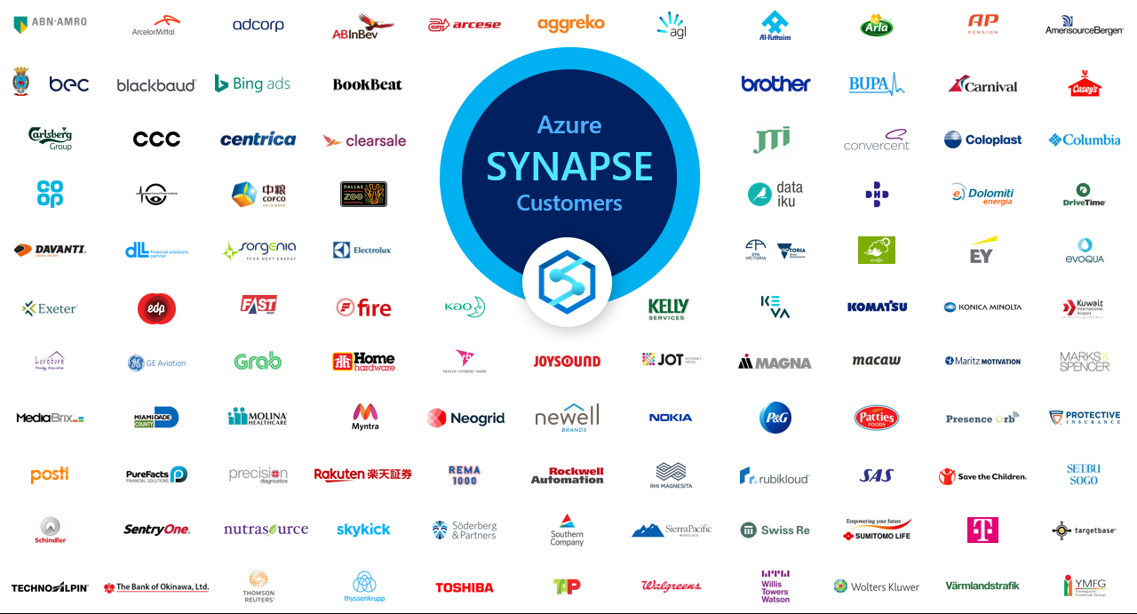
Azure Synapse customers

Slide 27
Get started today Learn more Start building with a free trial Attend a free Analytics in a Day workshop

Slide 28
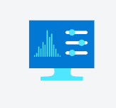

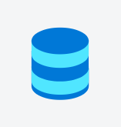





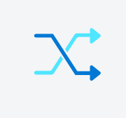

Key Services Capabilities
Unified analytics platform
Perform data integration, data exploration, data warehousing, big data analytics, and machine learning tasks from a single, unified environment.
Serverless and dedicated options
Support both data lake and data warehouse use cases and choose the most cost-effective pricing option for each workload.
Enterprise data warehousing
Build your mission-critical data warehouse on the proven foundation of the industry's top-performing SQL engine.
Data lake exploration
Bring together relational and nonrelational data and easily query files in the data lake with the same service you use to build data warehousing solutions.
Code-free hybrid data integration
Build ETL/ELT processes in a code-free visual environment to easily ingest data from more than 95 native connectors.
Deeply integrated Apache Spark and SQL engines
Enhance collaboration among data professionals working on advanced analytics solutions. Easily use T-SQL queries on both your data warehouse and Spark engines.
Log and telemetry analytics
Use industry-leading text-indexing technology to gain insights from time-series, log, and telemetry data with the Azure Synapse data explorer distributed query engine.
Choice of language
Use your preferred language, including T-SQL, KQL, Python, Scala, Spark SQL, and .Net—whether you use serverless or dedicated resources.
Integrated AI and BI
Complete your end-to-end analytics solution with deep integration of Azure Machine Learning, Azure Cognitive Services, and Power BI.
Cloud-native HTAP
Get insights from real-time transactional data stored in operational databases, such as Azure Cosmos DB, with a single click.

